Slide 1
Relational Database Management Systems (RDBMS):

Slide 2
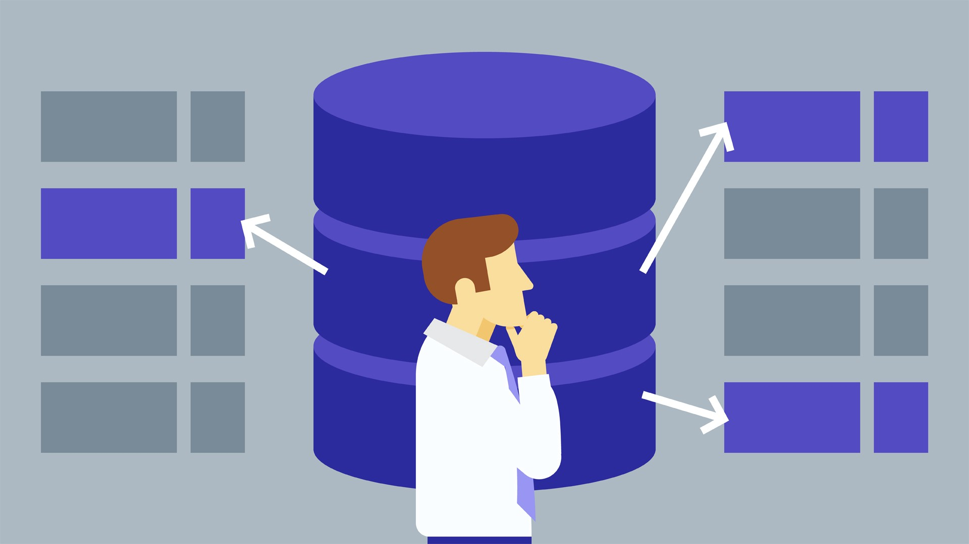
What is a Database Management System?
A database management system (DBMS) is software designed to store, retrieve, and manage data in databases. The most prevalent DBMS system is the RDBMS. The full form of RDBMS is Relational Database Management System. Now that it is clear what a database management system is let’s learn about the relational database management solution.

Slide 3
Comparing Database Management Systems: MySQL, PostgreSQL, MSSQL Server
So you are building a software application. One of the first problems to be solved is how to store your data. Which database will you choose?
A Database Management System or DBMS is a type of software that communicates with the database itself, applications, and user interfaces to obtain data and parse it. The DBMS also contains the key instruments to govern the database.
For our comparison, we’ve picked the 10 most commonly used database management systems: MySQL, MariaDB, Oracle, PostgreSQL, MSSQL, MongoDB, Redis, Cassandra, Elasticsearch, and Firebase. Concentrating on their business-related benefits and the challenges, we’ll also outline the best use cases for each.
Since databases are just a part of the whole data management strategy, learn about this comprehensive approach in our dedicated article.

Slide 4
MySQL
This is one of the most popular relational database systems. Originally an open-source solution, MySQL now is owned by Oracle Corporation. Today, MySQL is a pillar of LAMP application software. That means it’s a part of Linux, Apache, MySQL, and Perl/PHP/Python stack. Having C and C++ under the hood, MySQL works well with such system platforms as Windows, Linux, MacOS, IRIX, and others.

Slide 5
Pros of MySQL Free installation. The community edition of MySQL is free to download. With a basic set of tools for individual use, MySQL community edition is a good option to begin with. Of course, there are other, prepaid options for Enterprise or Cluster purposes with richer functionality. Nevertheless, if your company is too small to pay for one of them, the free-to-download model is the most suitable for a fresh start. Simple syntax and mild complexity. MySQL’s structure and style are very plain. Developers even consider MySQL a database with a human-like language. MySQL is often used in tandem with the PHP programming language. Because they share a gentle learning curve, it’s much easier to form a team to manage your database. Also, MySQL is easy to use. For instance, most of the tasks can be executed right in the command line, reducing development steps. Cloud compatibility. Business-oriented by nature and originally developed for the web, MySQL is supported by the most popular cloud providers. It’s available on such leading platforms as Amazon, Microsoft, and others. This makes MySQL even more attractive and gives businesses room for growth.
Cons of MySQL
Scalability challenges. MySQL was not built with scalability in mind, which is inherent in its code. In theory, you can scale MySQL, but it will need more engineering effort as compared to any of the NoSQL databases. So, if you expect one day your database will increase substantially, keep this limitation in mind or choose another DBMS option.
Partial open-source support. Although MySQL has the open-source part, it’s mostly under Oracle’s license. This limits the MySQL community in terms of improving the DBMS. Why do you care? Because when you have completely open-source support, you expect many problem-specific implementations and community assistance. This is not the case when the software belongs to corporate owners and you’ll have to pay for support.
Limited compliance with SQL standards. Structured Query Language has specific standards. MySQL doesn’t completely follow them, i.e. MySQL provides no support for some standard SQL features. On the other hand, MySQL has some extensions and distinct features that don’t match the Structured Query Language standards. It’s not a big deal for small web applications. The issues may appear when you have to shift to other databases, which is likely to happen when your business starts growing.
Use cases

Slide 6
PostgreSQL
This database management system shares its popularity with MySQL. This is an object-relational DBMS where user-defined objects and table approaches are combined to build more complex data structures. Besides that, PostgreSQL has a lot of similarities with MySQL. It’s aimed at strengthening the standards of compliance and extensibility. Consequently, it can process any workload, for both single-machine products and complex applications. Owned and developed by PostgreSQL Global Development Group, it still remains completely open-source. This DBMS is available for use with such platform systems as Microsoft, iOS, Android, and many more.

Slide 7
Pros of Postgre Great scalability. Vertical scalability is a hallmark of PostgreSQL, unlike MySQL DBMS. Considering that almost any custom software solution tends to grow, resulting in database extension, this particular option certainly supports business growth and development. Support for custom data types. PostgreSQL natively supports a large number of data types by default, such as JSON, XML, H-Store, and others. PostgreSQL takes advantage of it, being one of the few relational databases with strong support for NoSQL features. Additionally, it allows users to define their own data types. As your software business model may need different types of databases throughout its existence for better performance or application comprehensiveness, this option brings improved flexibility to the table. Easily-integrated third-party tools. PostgreSQL database management system has the strong support of additional tools, both free and commercial. The scope of these includes extensions to improve many aspects. For example, ClusterControl provides impressive assistance at managing, monitoring, and scaling SQL and NoSQL open source databases. To make data comparison and synchronization more effective, consider using DB Data Difftective. In case you’re going to scale up your data to heavy workloads, pgBackRest backup and restore system will be a nice option to choose. Open-source and community-driven support. Postgres is completely open-source and supported by its community, which strengthens it as a complete ecosystem. Additionally, developers can always expect free and prompt community assistance.
Cons of Postgre
Inconsistent documentation. While PostgreSQL has a large community and provides strong support for its participants, the documentation still lacks consistency and completeness. As the PostgreSQL community is rather distributed, the documentation doesn’t follow equal standards for all Postgre features.
Lack of reporting and auditing instruments. A significant shortcoming of PostgreSQL is the absence of revising tools that would show the current condition of a database. You have to continuously check if something goes wrong. There’s always a risk that DB engineers will notice a failure too late.

Slide 8
MSSQL
As a completely commercial tool, Microsoft SQL Server is one of the most popular relational DBMS, in addition to MySQL, PostgreSQL, and Oracle. It copes well with effective storing, changing, and managing relational data. To interact with SQL Server databases, DB engineers usually utilize the Transact-SQL (T-SQL) language, which is an extension of the SQL standard.

Slide 9
Pros of MSSQL Variety of versions. Microsoft SQL Server provides a wide choice of different options with diverse functionalities. For instance, the Express edition with a free database offers entry-level tooling, the perfect match for learning and building desktop or small server data-driven applications. The Developers option allows for building and testing applications including some enterprise functionalities, but without a production server license. For bigger projects, there are also Web, Standard, and Enterprise editions, with a varying extent of administrative capabilities and service levels. End-to-end business data solution. With a focus on mostly commercial solutions, MSSQL provides a lot of business value-added features. The optional selection of components allows building ETL solutions, forming a knowledge base, and implementing data clearance. Also, it provides tools for overall data administration, online analytical processing, and data mining, additionally providing options for report and visualization generation. Rich documentation and community assistance. With Microsoft SQL Server aimed at comprehensive database maintenance, the full online documentation also reflects this concept. The consequently structured guidelines, numerous whitepapers, and demos give a full picture of the MSSQL data system. Also, Microsoft Premier provides access to dedicated Microsoft community support, which is an advantage when a DB engineer needs assistance. Cloud database support. Being a part of the consistent Microsoft ecosystem, MSSQL can be integrated with Microsoft cloud, Azure SQL Database, or SQL Server on Azure Virtual Machines. The solutions allow shifting database administration to the cloud if your business software database becomes really overwhelming and hard to administer.
Cons of MSSQL
High cost. Being mostly used at enterprise scale, MSSQL Server remains one of the most expensive solutions. Speaking of numbers, the Enterprise edition currently costs over $14, 000 per core, sold as 2 core packs.
Unclear and floating license conditions. Another issue is the ever-changing licensing process. The pricing strategy itself is hard to understand and the elements included in a particular edition are floating, tending to shift from one to another.
Complicated tuning process. For those beginners who have to operate heavy data sets, working with query optimization and performance tuning may be problematic. As the process is not so obvious, it can create substantial bottlenecks early on.

Slide 10
